Slide 1
BTP Presentation
Sunny Saxena(20ucs205)
Aryan Shrivastava(20ucc023)
Raunak Gupta(20uec103)

Slide 2
Elections and Media Coverage:
Sentiment and Language Analysis
Using Python, Web
Scraping and NLP & various libraries

Slide 3
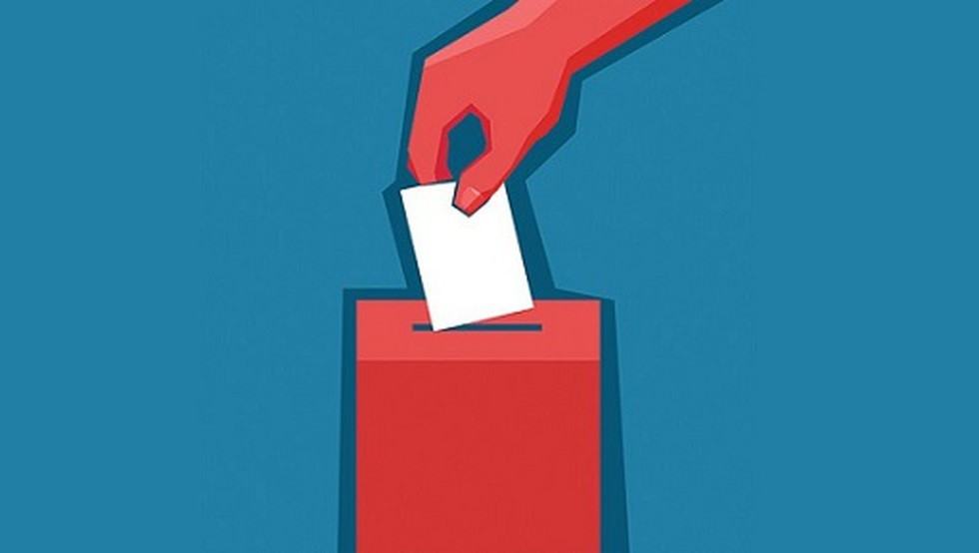

How Media Influence Elections?
Candidate Exposure
Polarizing and Framing Information
Political debate and interviews

Slide 4
Objectives
To analyze the polarity and emotions in various speeches
Comparing the Articles reporting the speech by different media houses on the basis of emotional and sentimental analysis
Implementing NER and Emotional analysis for more in depth analysis

Slide 5
Sentimental Analysis
Sentiment analysis, also known as opinion mining, is a natural language processing (NLP) technique used to determine the sentiment or emotional tone expressed in a piece of text.[2]
Sentiment analysis involves analyzing text data, such as customer reviews, social media posts, or news articles, to identify and categorize the sentiment as positive, negative, or neutral.

Slide 6
History of Sentimental Analysis
Liu's lexicon-based approach (2005) used a sentiment lexicon containing positive and negative words to determine the sentiment of a text based on the frequency of positive and negative words in the text.
Pang et al.'s work (2002) used a supervised machine learning approach, specifically a Naive Bayes classifier, to classify movie reviews as positive or negative based on word features.
Blitzer et al.'s work (2007) proposed an ensemble approach that combines multiple classifiers, including Naive Bayes, Maximum Entropy, and Support Vector Machines, to improve sentiment classification accuracy.

Slide 7
What is Polarity?
Polarity refers to the emotional or sentiment orientation of a piece of text, which can be positive, negative, or neutral
Positive polarity indicates a positive sentiment, such as happiness, satisfaction, or excitement.
Negative polarity indicates a negative sentiment, such as anger, sadness, or disappointment.
Neutral polarity indicates an absence of any strong positive or negative sentiment

Slide 8
What is Subjectivity?
Subjectivity refers to the degree to which a piece of text expresses subjective or personal opinions, feelings, or perspectives, rather than objective facts or information.
Example :
Rahul is a boy has subjectivity as zero.
Rahul is a good boy has subjectivity as 0.7.

Slide 9
Data Preprocessing For Sentiment Analysis
Tokenization: Break down the text data into individual words or tokens. Tokenization is the process of splitting text into smaller units, such as words, phrases, or sentences, to analyze them individually.[]
Stopword Removal: Remove common words known as stopwords, such as "the", "and", "is", etc., that do not carry significant meaning in the text. Stopword removal helps reduce noise and irrelevant information in sentiment analysis.

Slide 10
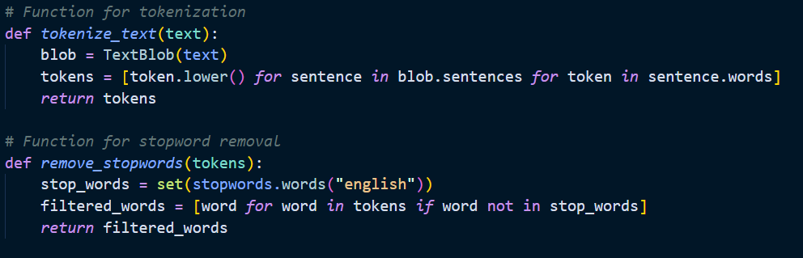
Data Preprocessing Functions

Slide 11
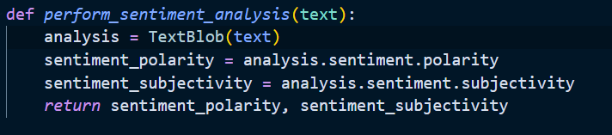
Sentimental Analysis Functions

Slide 12
Why Sentiment Analysis is not enough?
Sentimental Analysis is not enough for analyzing News articles or speeches as there are also various emotions involved in them and sentiment analysis just gives the polarity of the text
To include various emotions in a news article we have included emotional analysis in our work

Slide 13
Emotional Analysis
Emotional analysis can identify and categorize various emotions such as joy, anger, fear, sadness, surprise, and disgust
Emotional analysis database used:
https://www.kaggle.com/datasets/wjburns/nrc-emotion-lexicon

Slide 14
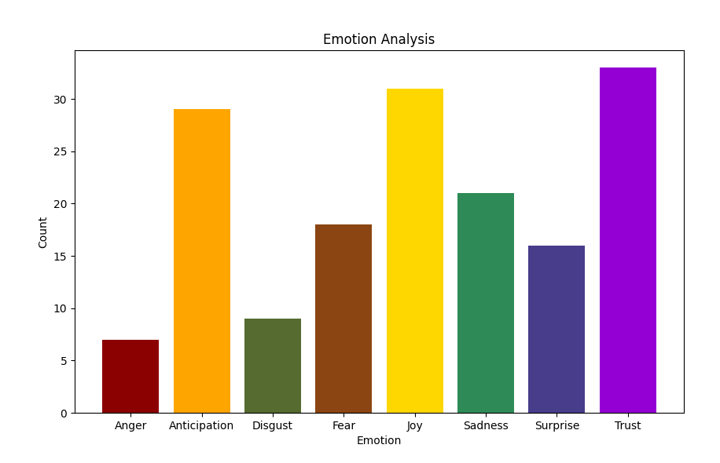
Emotional Analysis of Speech By Steve Jobs
Stanford University

Slide 15
What is Name Entity Recognition(NER)
Entity analysis, also known as named entity recognition (NER), is a natural language processing (NLP) technique used to identify and extract named entities (i.e., specific objects, people, places, organizations, and more) from unstructured text data.[3]
The process involves analyzing a given text and identifying the relevant entities, categorizing them into predefined types, such as person, organization, location, product, date, and so on.

Slide 16
Why we need to include NER along with Sentiment Analysis and Emotional Analysis?

Slide 17
How have we used Name Entity Recognition
Step 1: We looked for names of person or organizations in the text and then looked for the major recurring entities.
Step 2: We group together the sentences ,sections and parts that have the entities in it and then create a new string
Step 3: We then use this string to perform emotional and sentimental analysis in this way we are able to get the emotional stats for each entity separately.

Slide 18
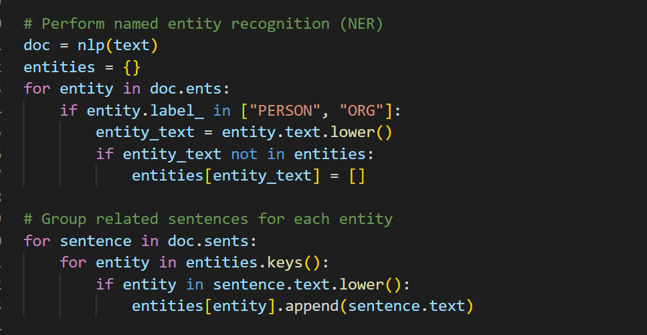
Corresponding Code Snippet

Slide 19
Analysis of Sh. Narendra Modi Speech in
Wardha, Maharashtra

Slide 20
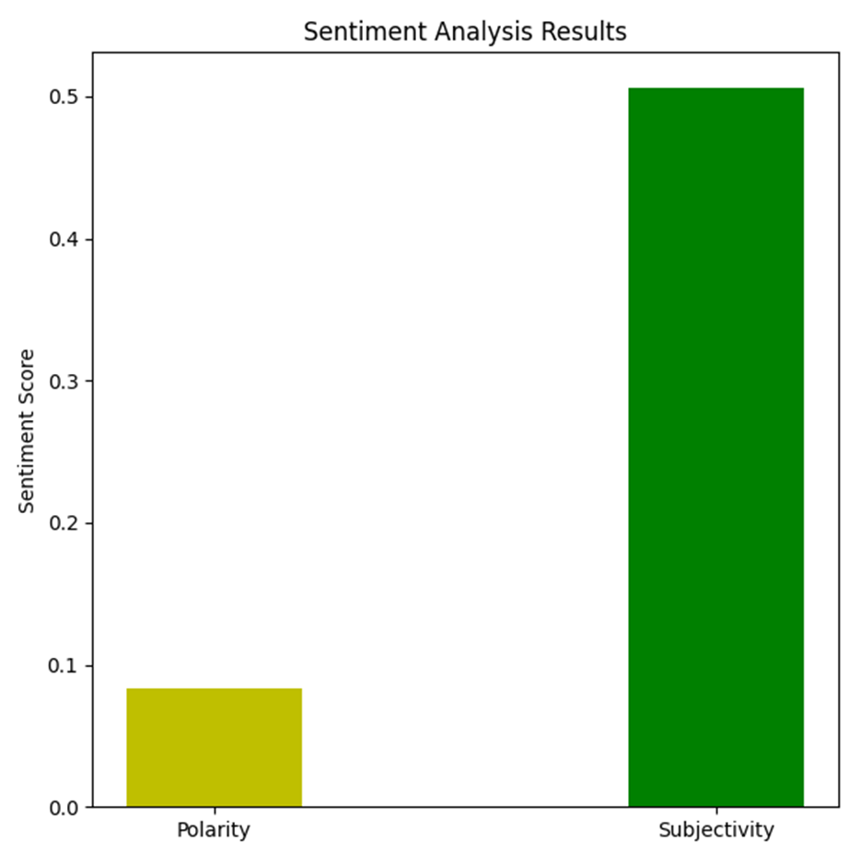
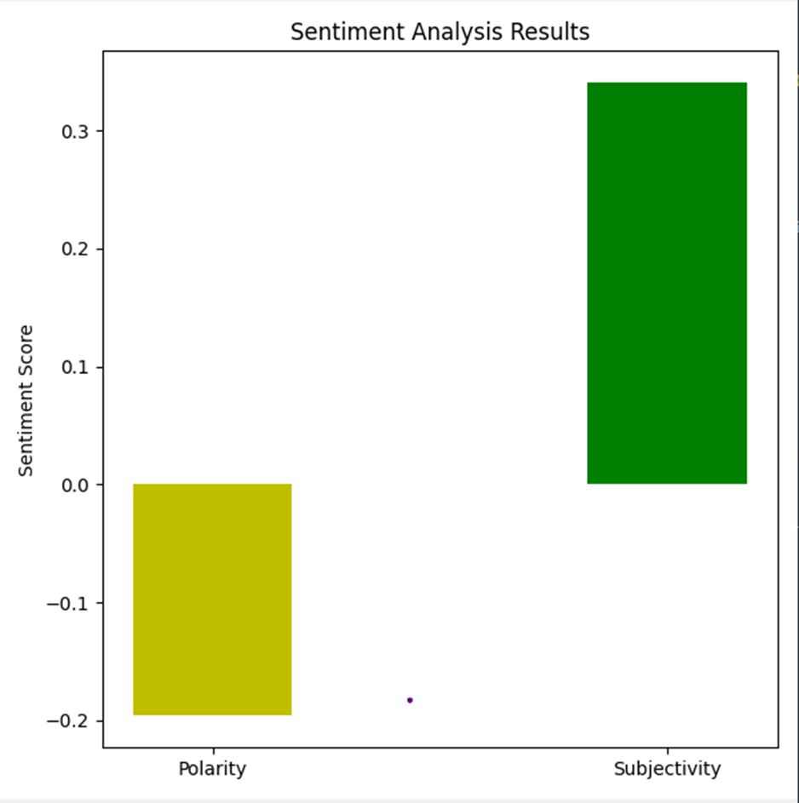
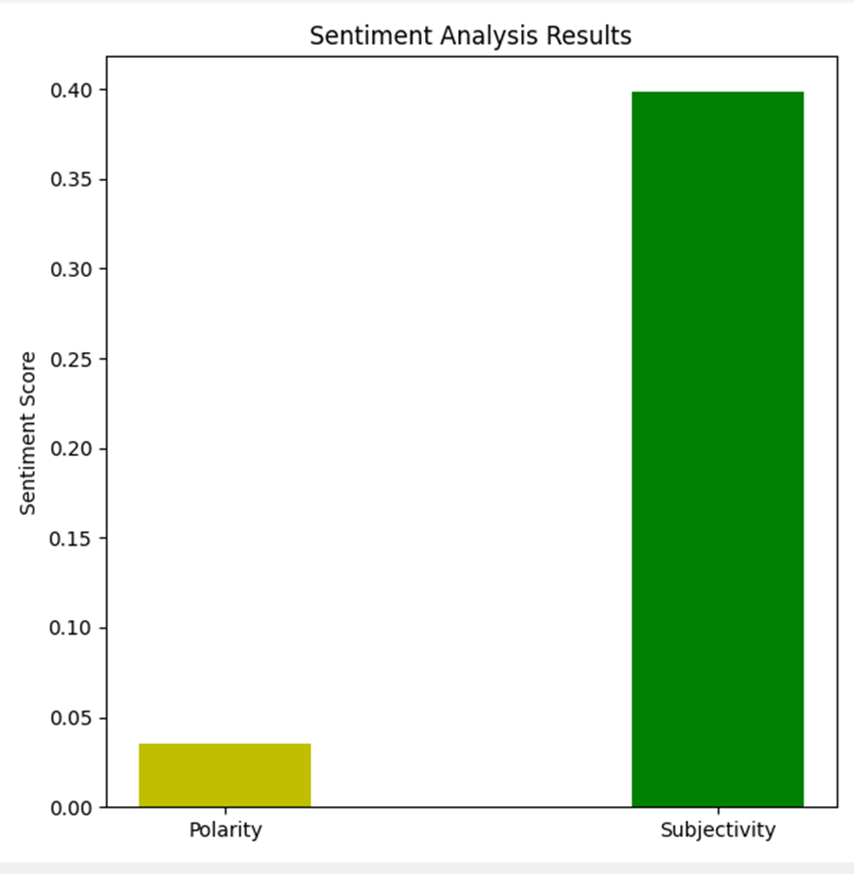
Sh. Narendra Modi Speech in Wardha
Sentiment Analysis of Speech
Sentiment Analysis of OP India
Sentiment Analysis of Indian Express
s

Slide 21
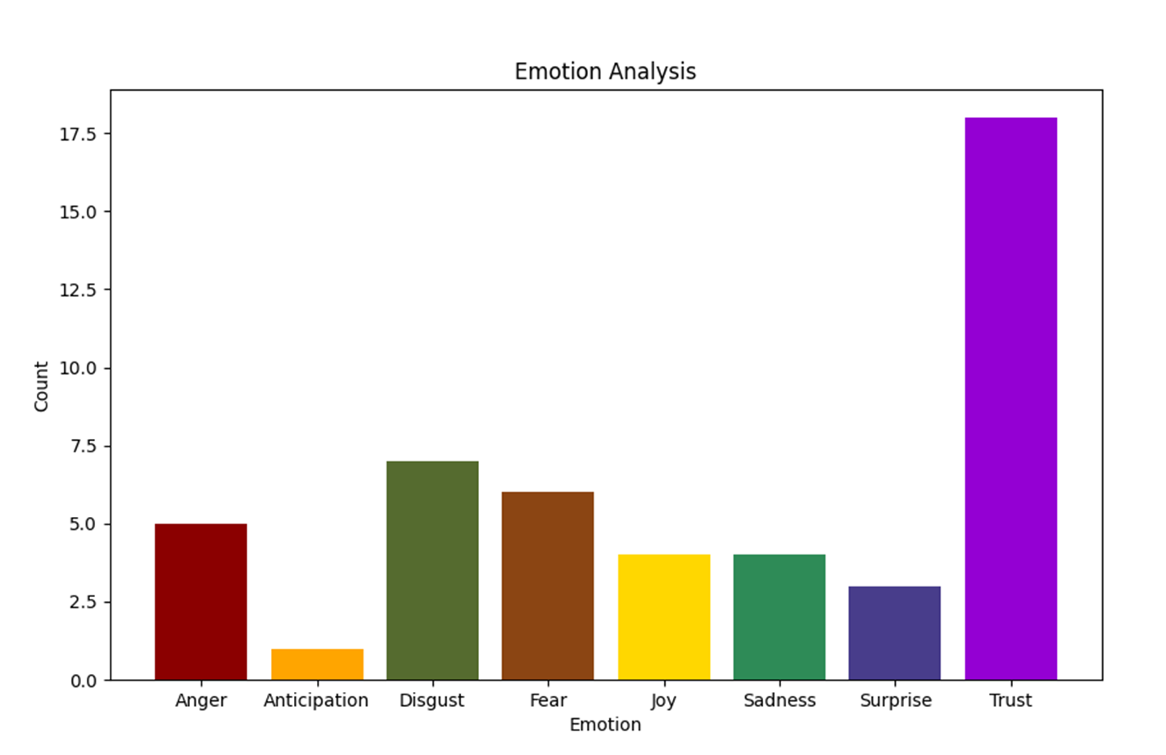
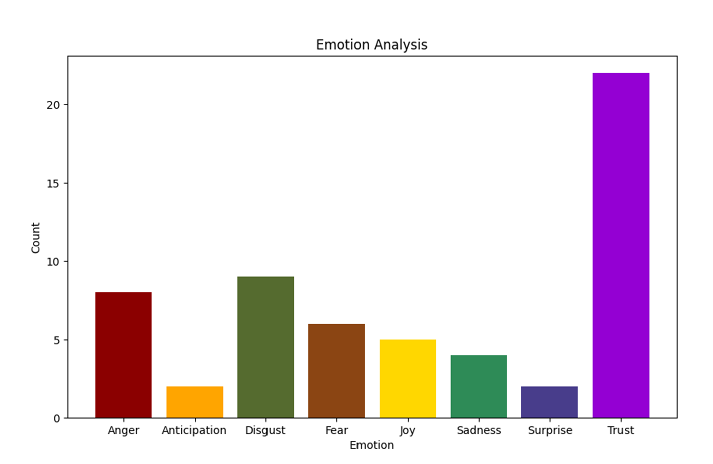
Sh. Narendra Modi Speech in Wardha
Emotional Analysis of
OP India
Emotional Analysis Of The Indian Express

Slide 22
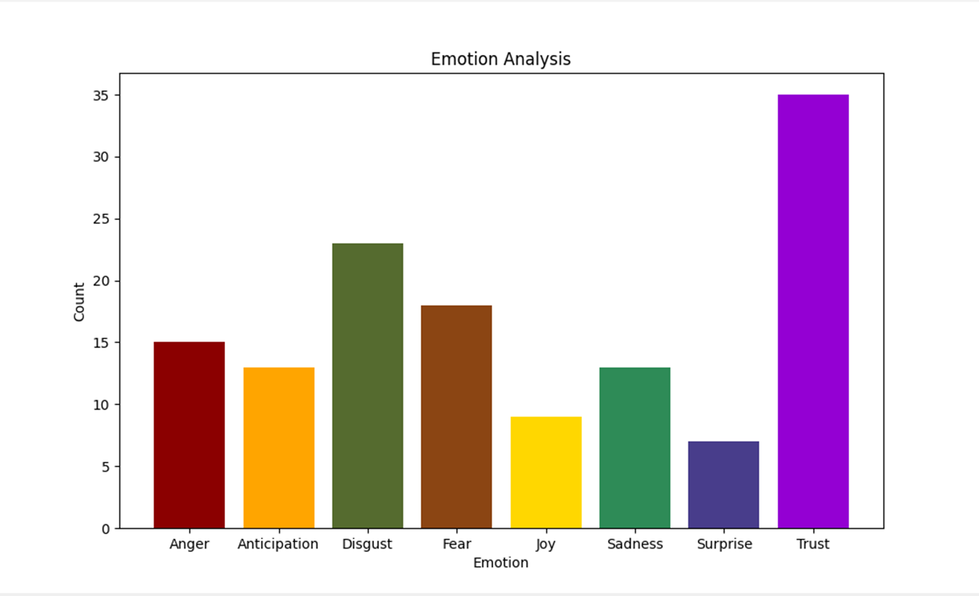
Sh. Narendra Modi Speech in Wardha
Emotional Analysis of Speech

Slide 23
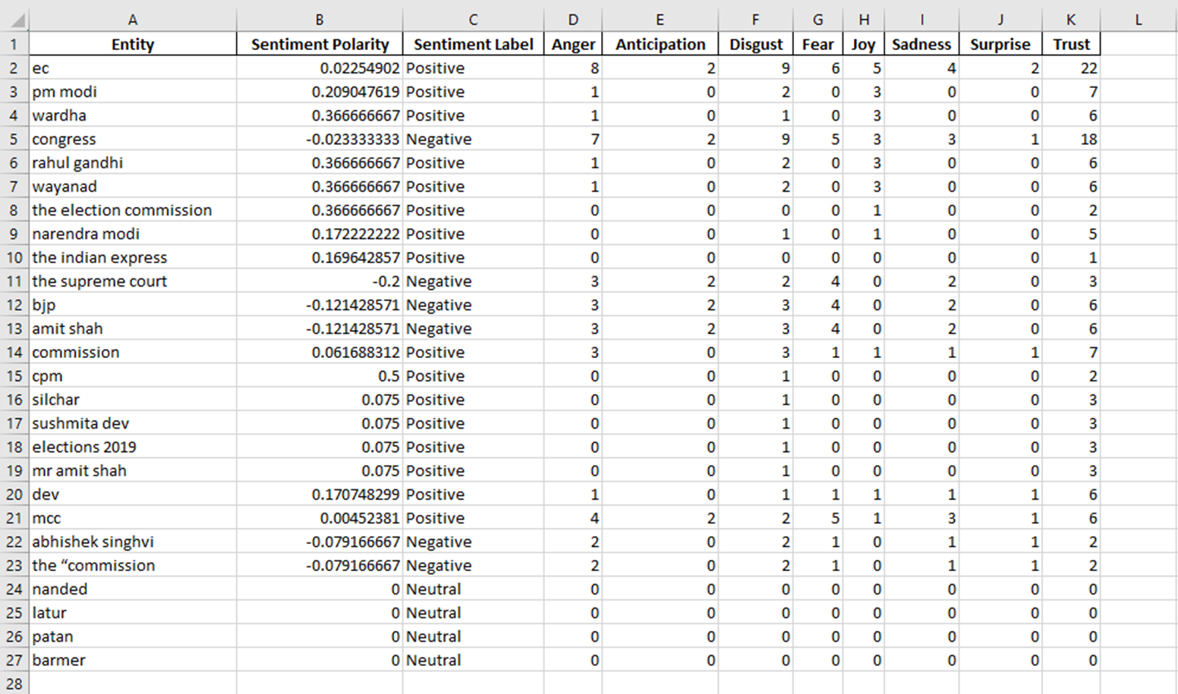
Entity Analysis of Speech

Slide 24
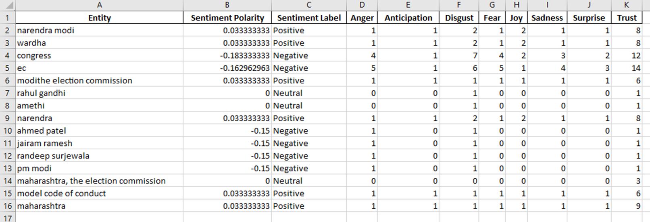
Entity Analysis of OP India

Slide 25
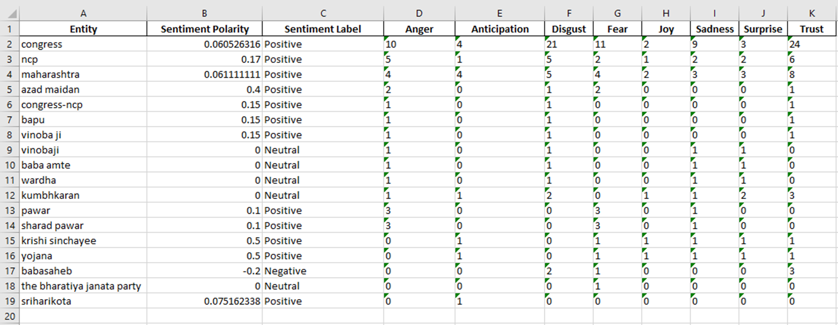
Entity Analysis of The Indian Express

Slide 26
Analysis of Speech by Sh. Narendra Modi in Meerut (Uttar Pradesh)

Slide 27
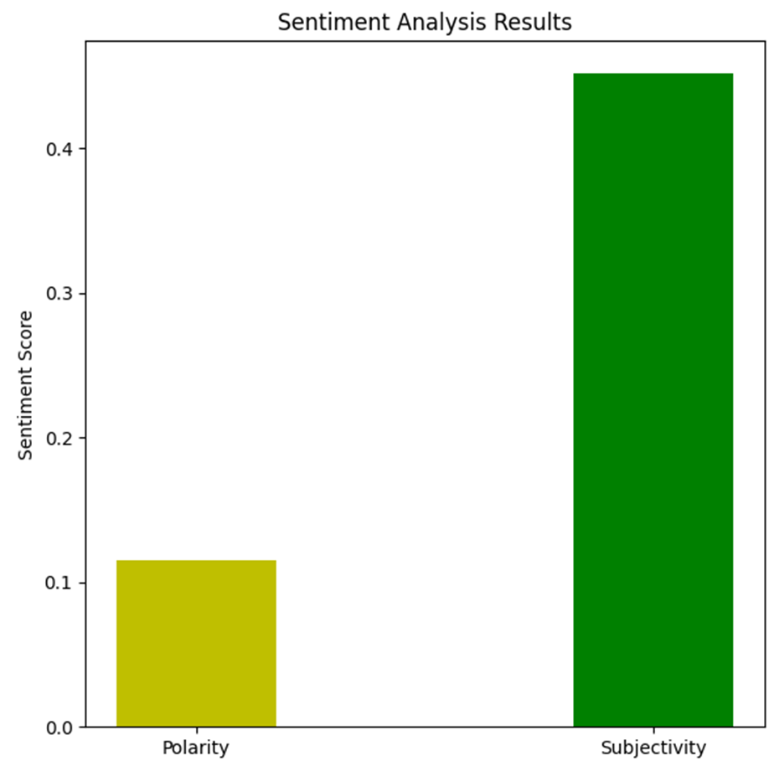
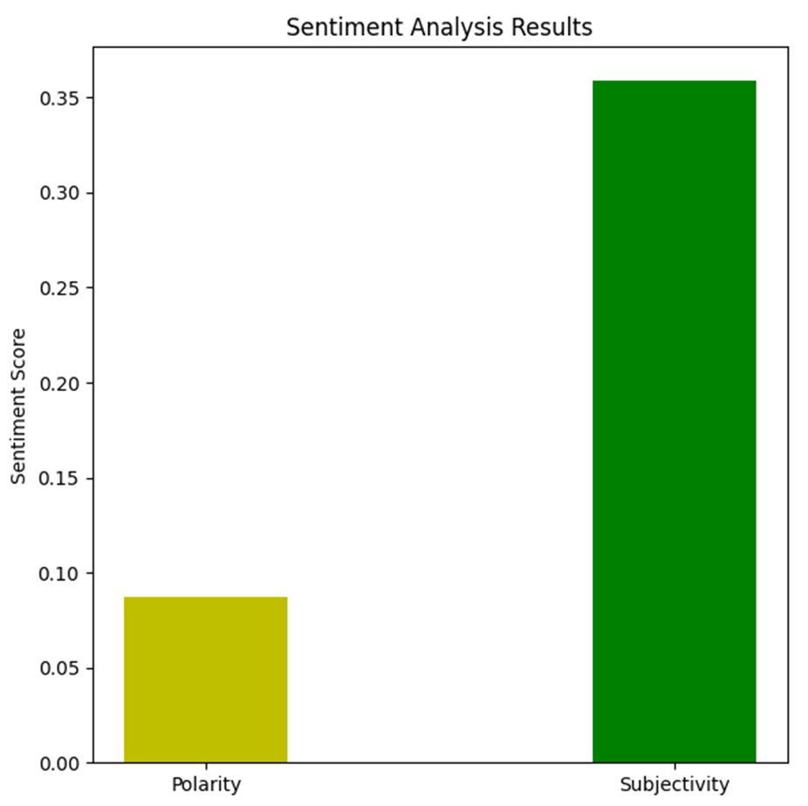
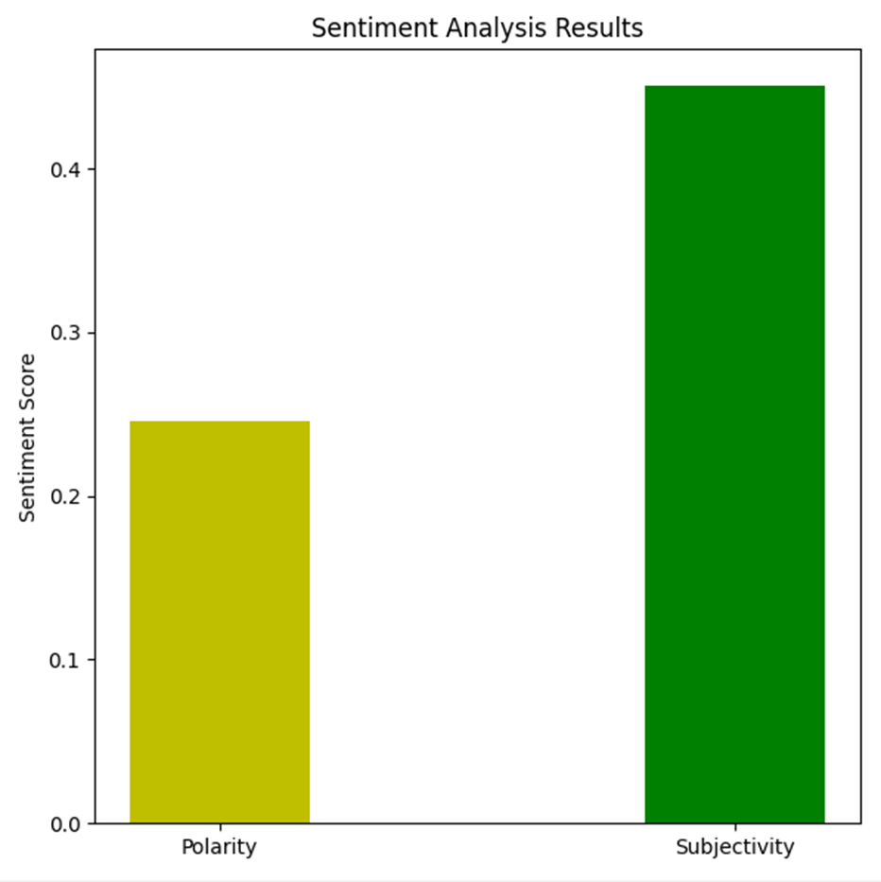
Sh. Narendra Modi Speech in Meerut
Sentiment Analysis of Speech
Sentiment Analysis of Hindustan Times
Sentiment Analysis of OP india
s

Slide 28
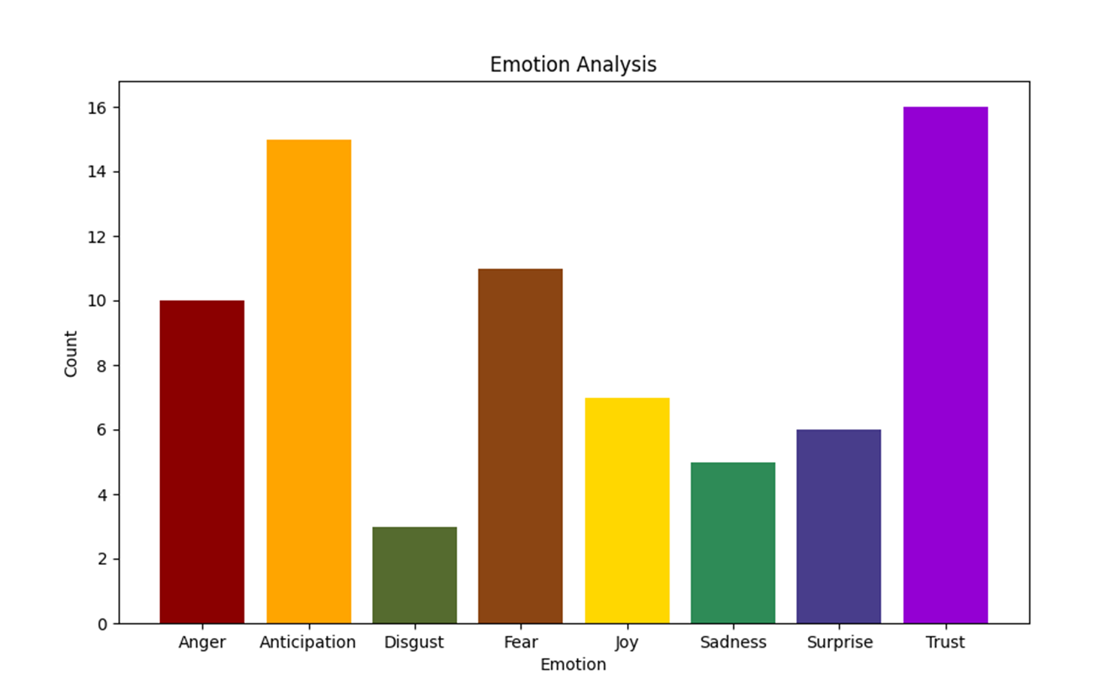
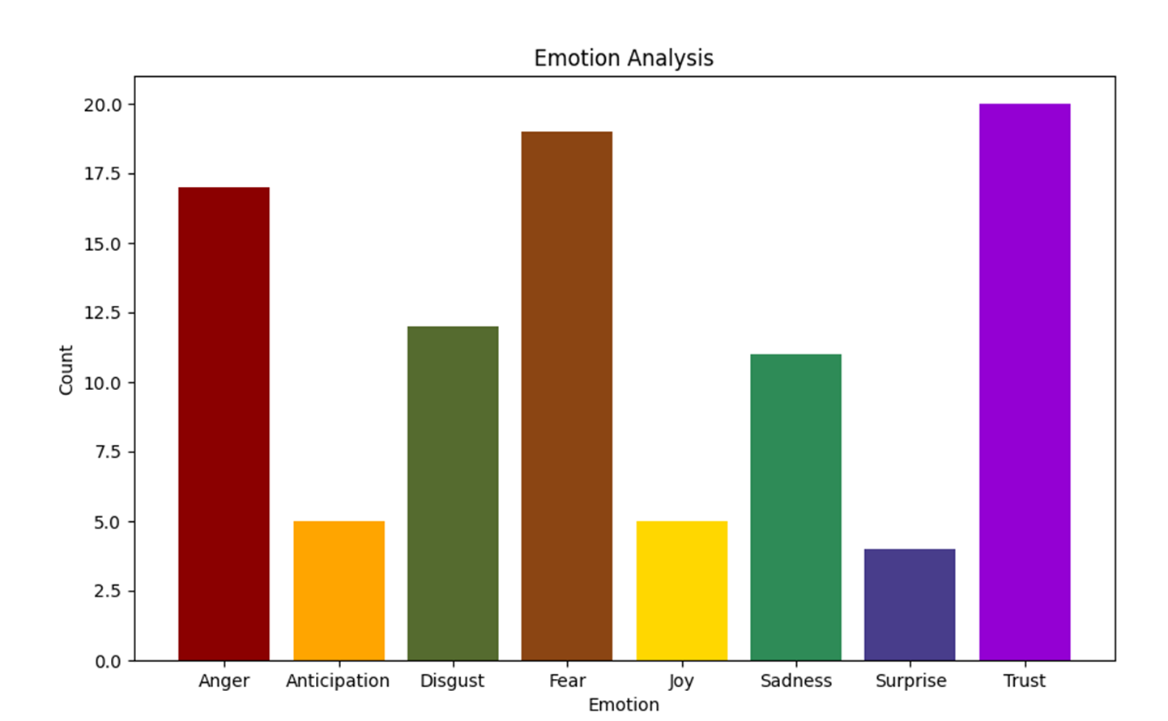
Sh. Narendra Modi Speech in Meerut
Emotional Analysis of The Hindustan Times
Emotional Analysis of
OP India

Slide 29
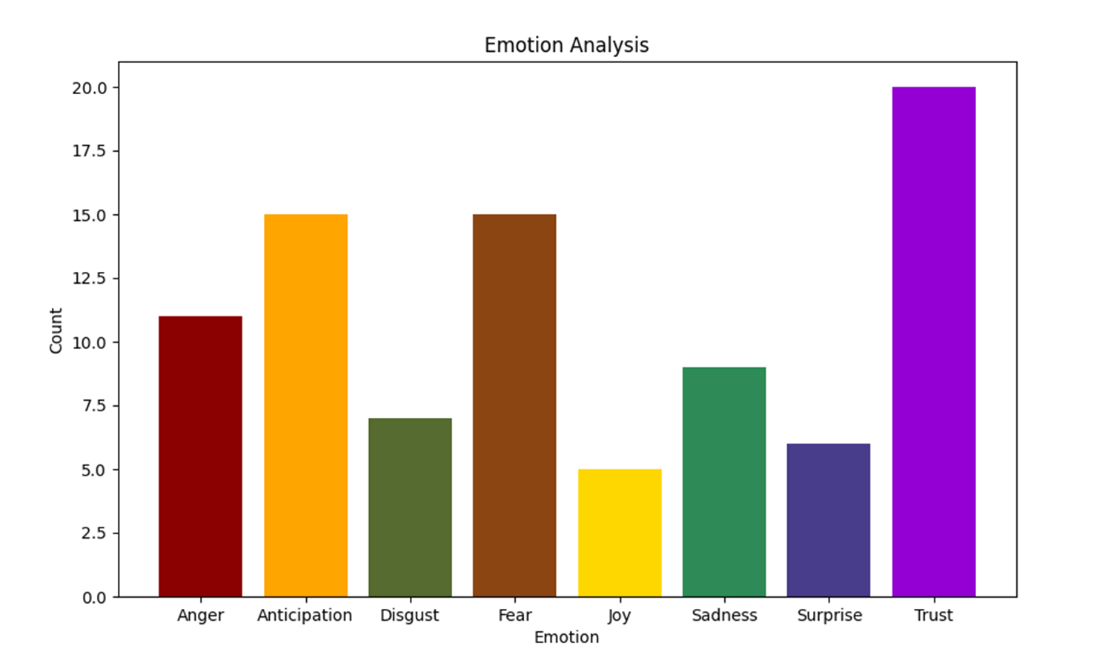
Sh. Narendra Modi Speech in Meerut
Emotional Analysis of
Speech

Slide 30
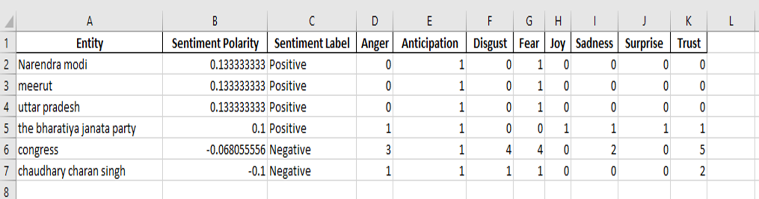
Entity Analysis of Speech

Slide 31
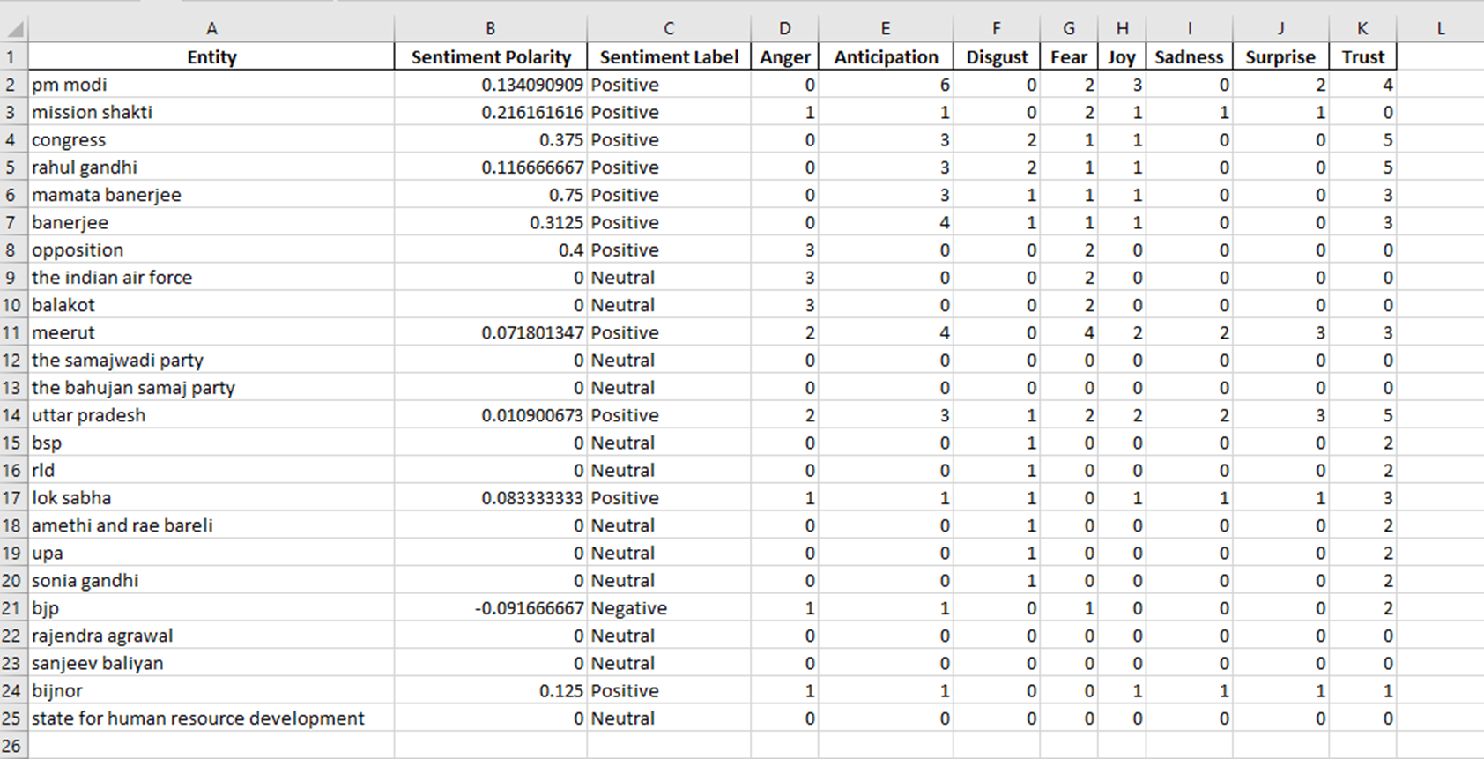
Entity Analysis of The Hindustan Times

Slide 32
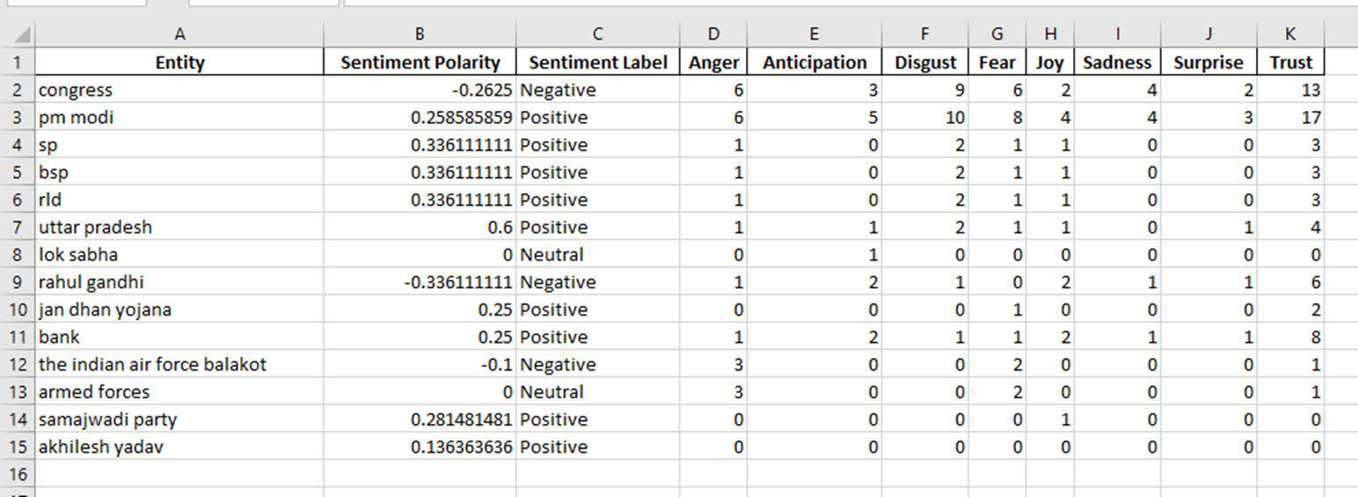
Entity Analysis of OP India

Slide 33
Analysis of Sh. Narendra Modi Speech in Varanasi (Uttar Pradesh)
27 May 2019

Slide 34
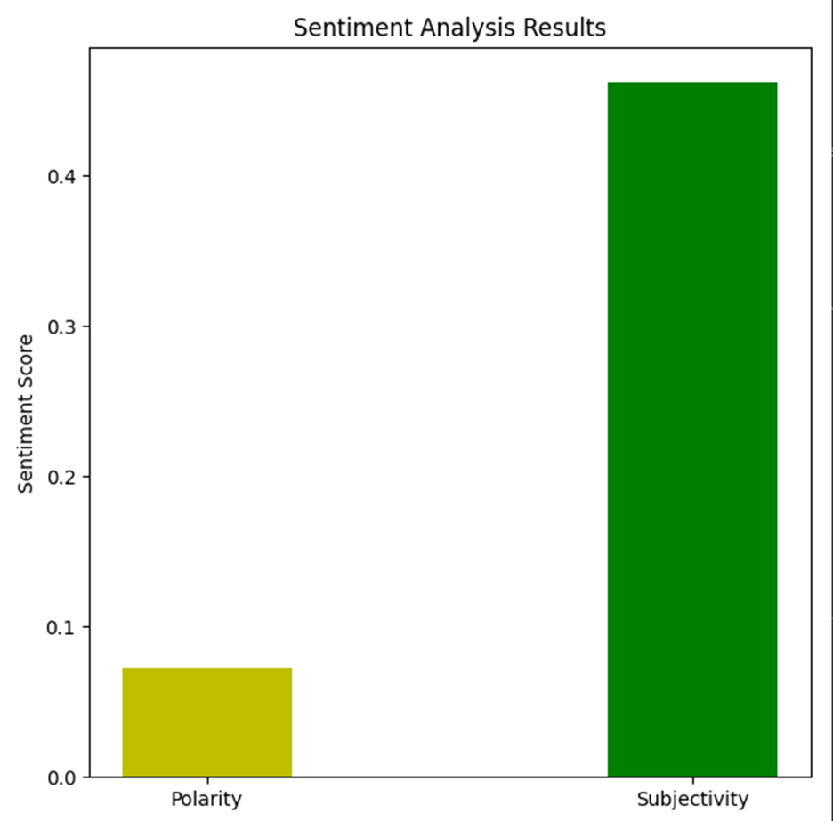
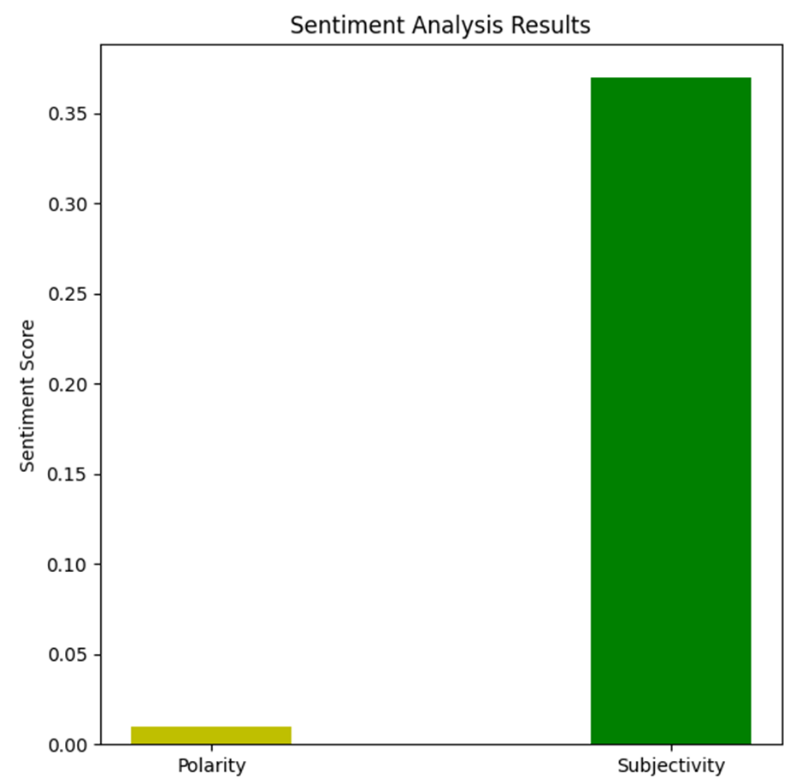
Sh. Narendra Modi Speech in Varanasi
Sentiment Analysis of
Speech
Sentiment Analysis of
The Indian Express

Slide 35
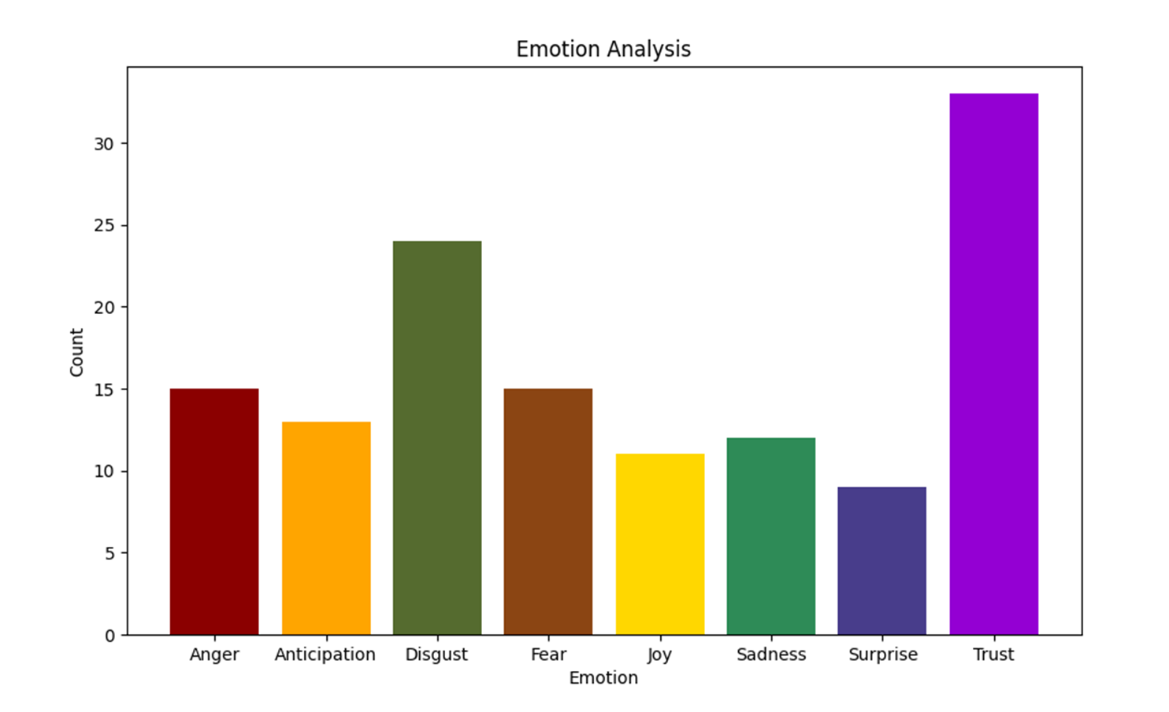
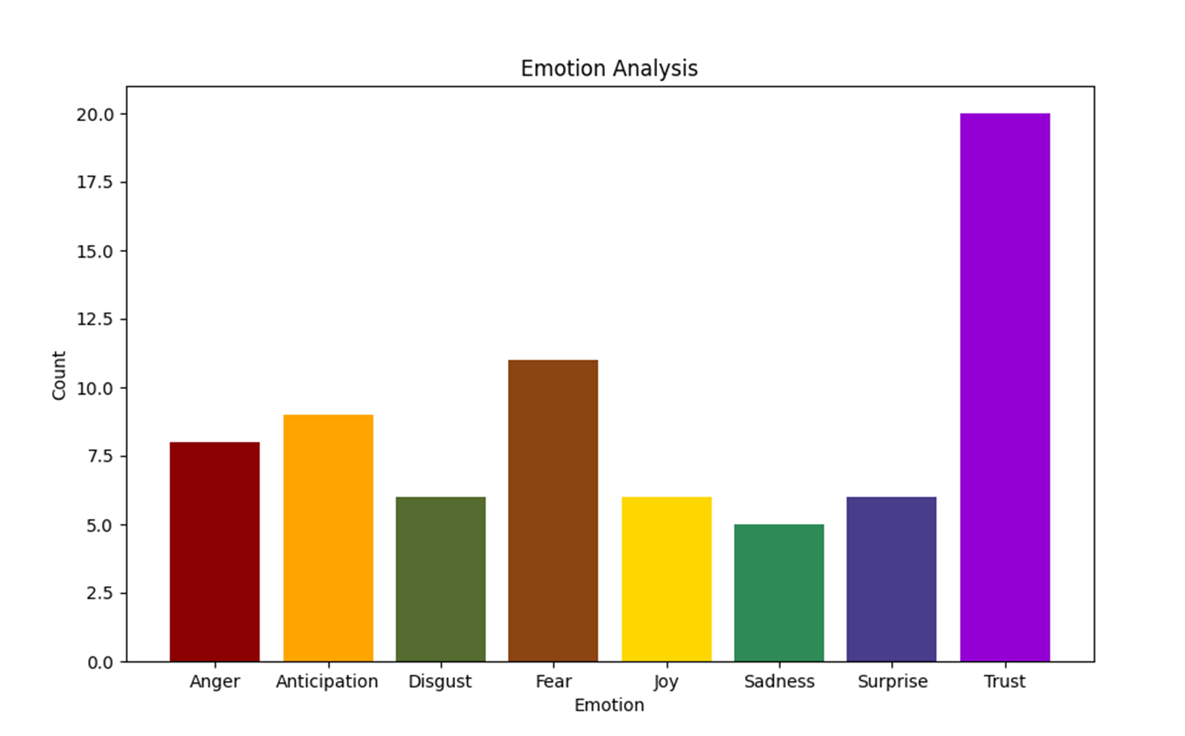
Sh. Narendra Modi Speech in Varanasi
Emotional Analysis of
The Indian Express
Emotional Analysis of Speech

Slide 36
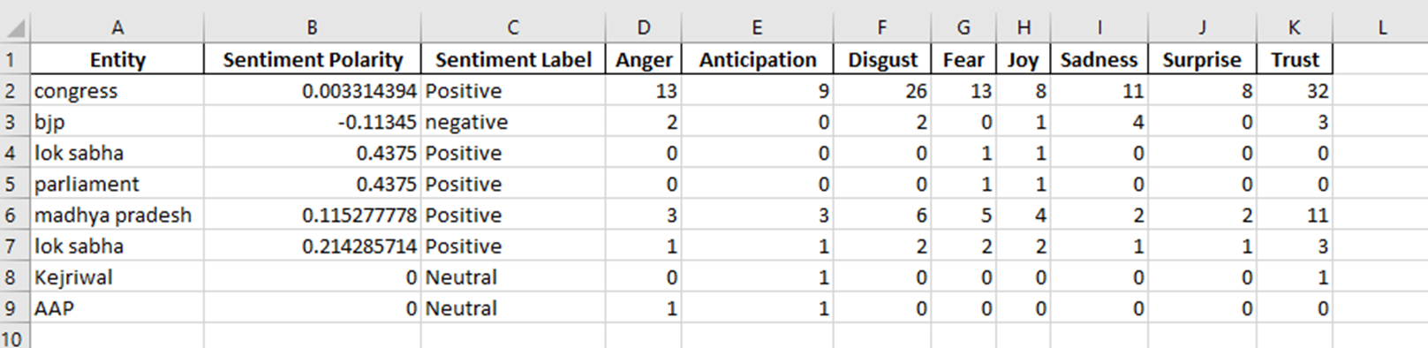
Entity Analysis of Speech

Slide 37
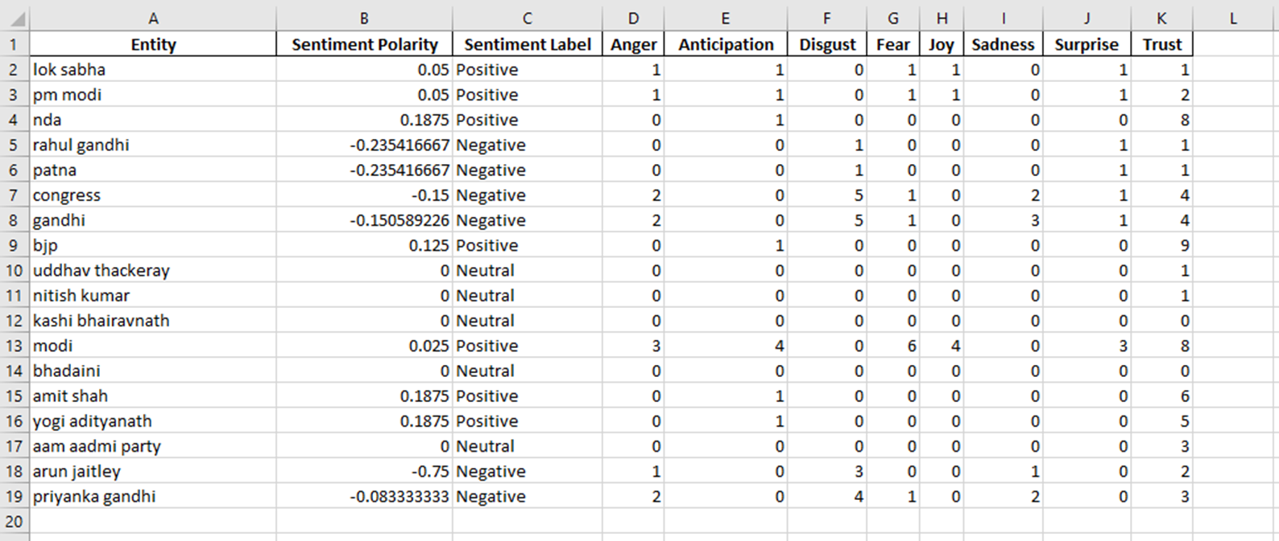
Entity Analysis of The Indian Express

Slide 38
Speech of Sh. Narendra modi in Kolkata on
3 April 2019

Slide 39
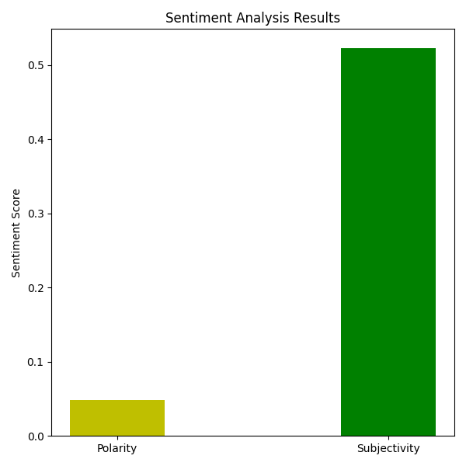
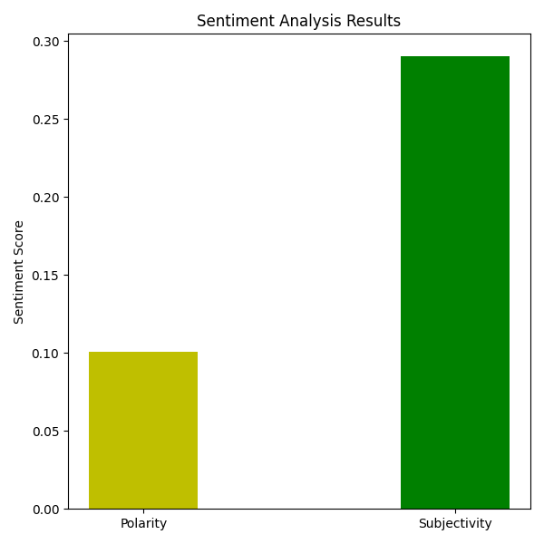

Sh. Narendra Modi Speech in Kolkata
Sentiment Analysis of Speech
Sentiment Analysis of India Today
Sentiment Analysis of OP India
s

Slide 40
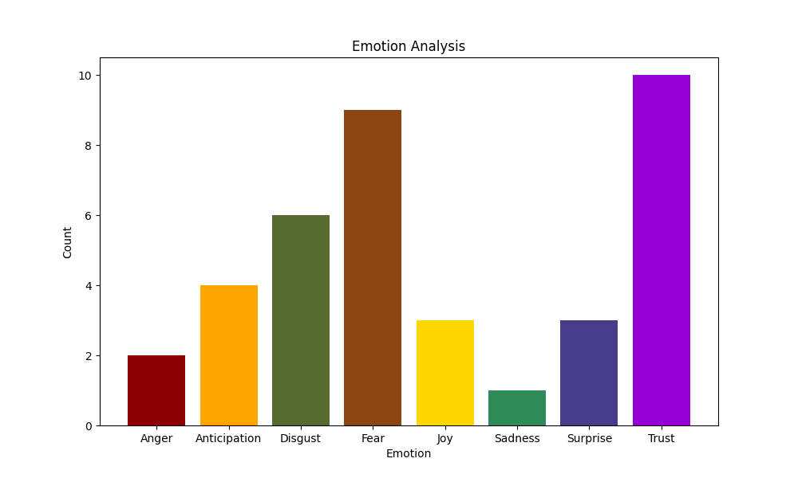
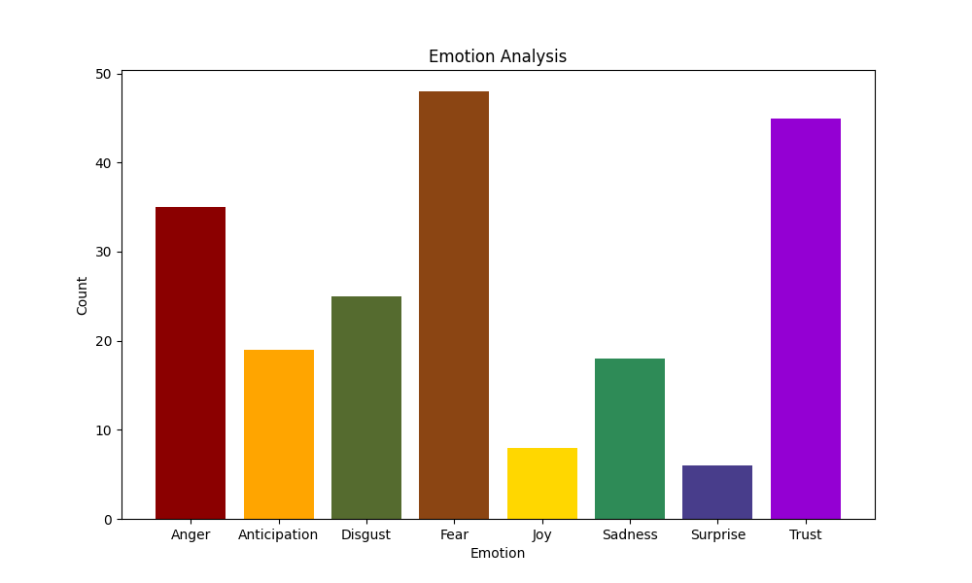
Sh. Narendra Modi Speech in Kolkata
Emotional Analysis of
India Today
Emotional Analysis Of The
OP India

Slide 41
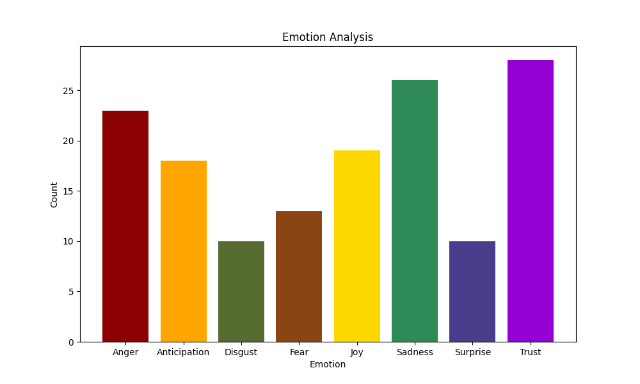
Sh. Narendra Modi Speech in Kolkata
Emotional Analysis of Speech

Slide 42
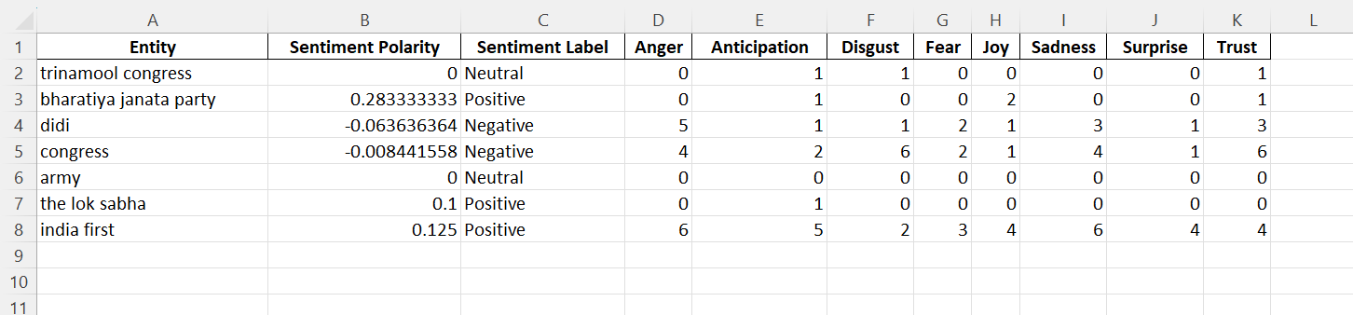
Entity Analysis of Speech

Slide 43
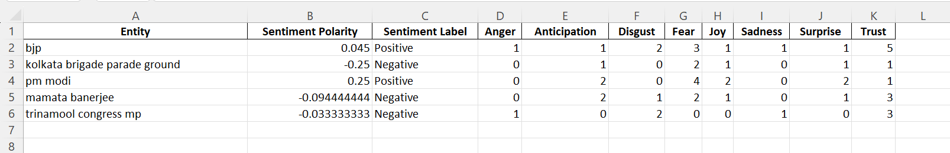
Entity Analysis of India Today

Slide 44
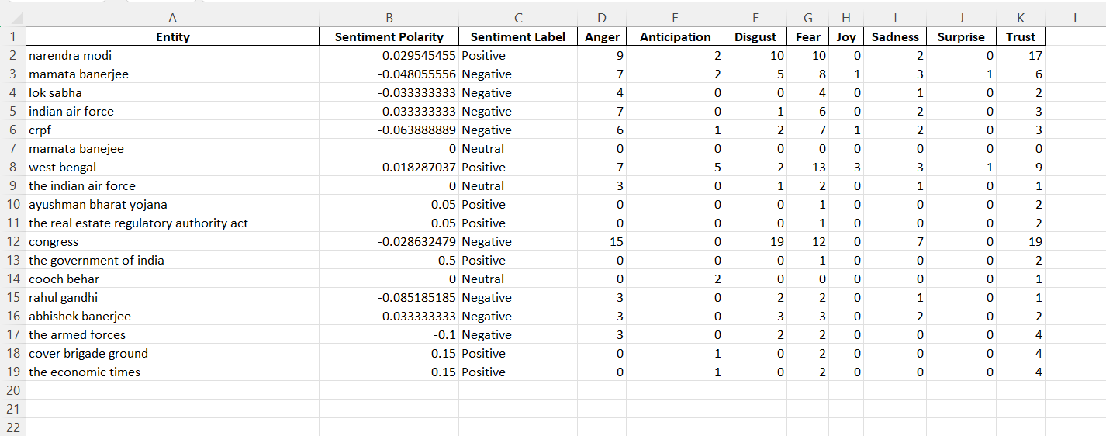
Entity Analysis of The OP India

Slide 45
Sh. Rahul Gandhi Addressed at Indira Gandhi Indoor Stadium, New Delhi

Slide 46
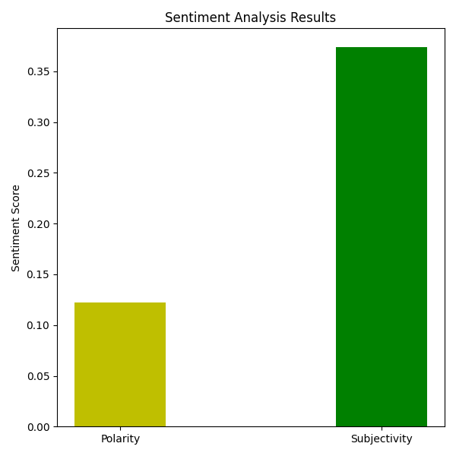
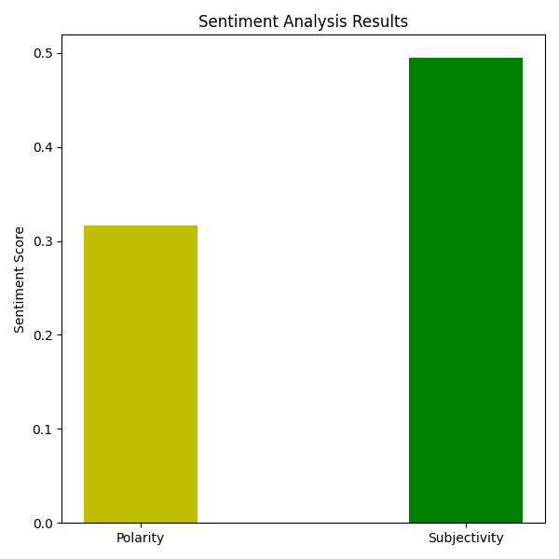
Sh. Rahul Gandhi Speech in New Delhi
Sentiment Analysis of Speech
Sentiment Analysis of MillenniumPost
s

Slide 47
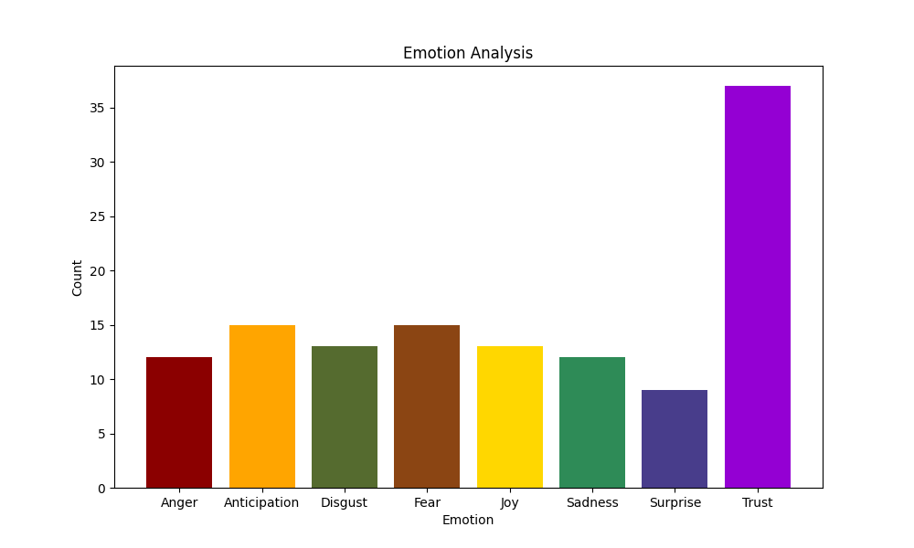
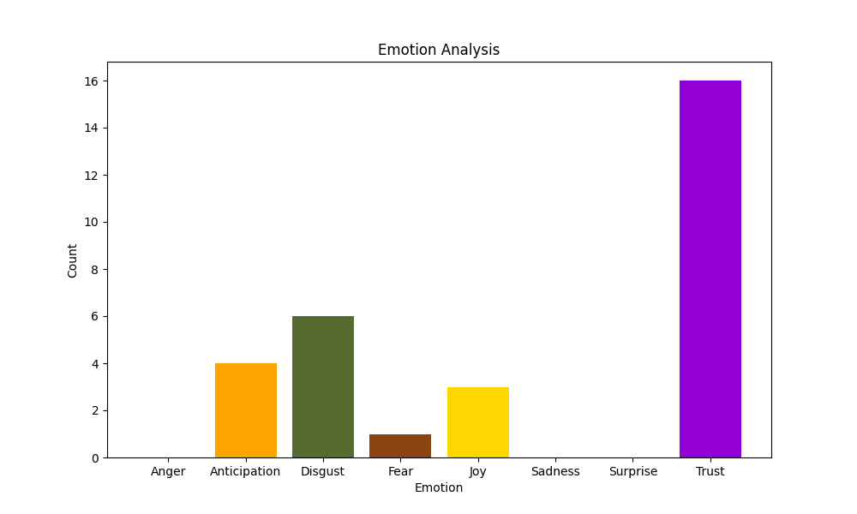
Sh. Rahul Gandhi Speech in New Delhi
Emotional Analysis of
Speech
Emotional Analysis Of The
MillenniumPost

Slide 48
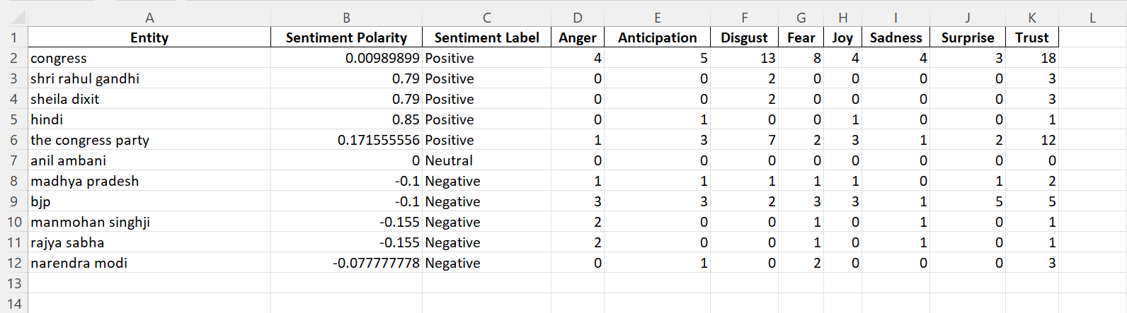
Entity Analysis of Speech

Slide 49
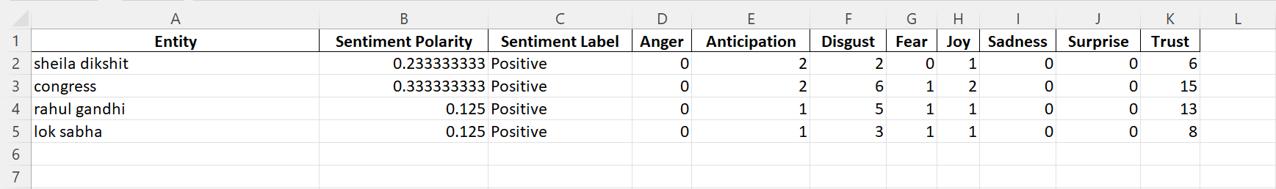
Entity Analysis of MillenniumPost

Slide 50
Sh. Rahul Gandhi Addressed at Jeypore, Odisha

Slide 51


Sh. Rahul Gandhi Speech in Odisha
Sentiment Analysis of
Speech
Sentiment Analysis of The Telegraph Online

Slide 52
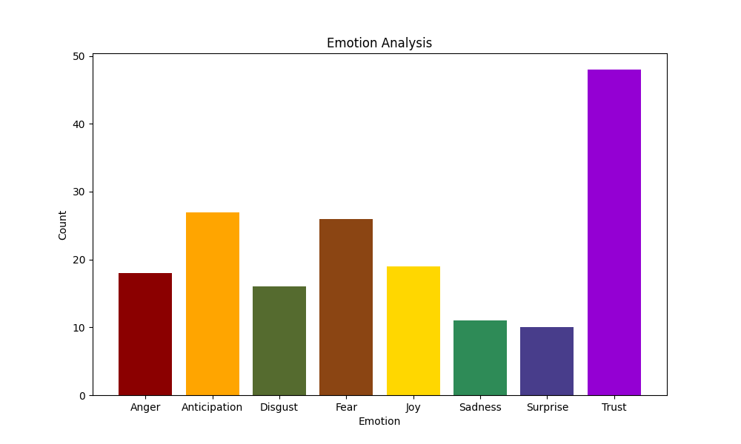
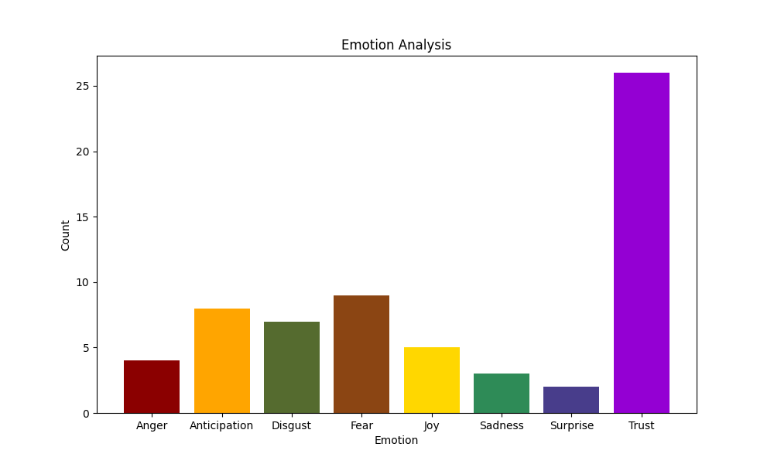
Sh. Rahul Gandhi Speech in Odisha
Emotional Analysis of
Speech
Emotional Analysis Of The
The Telegraph Online

Slide 53
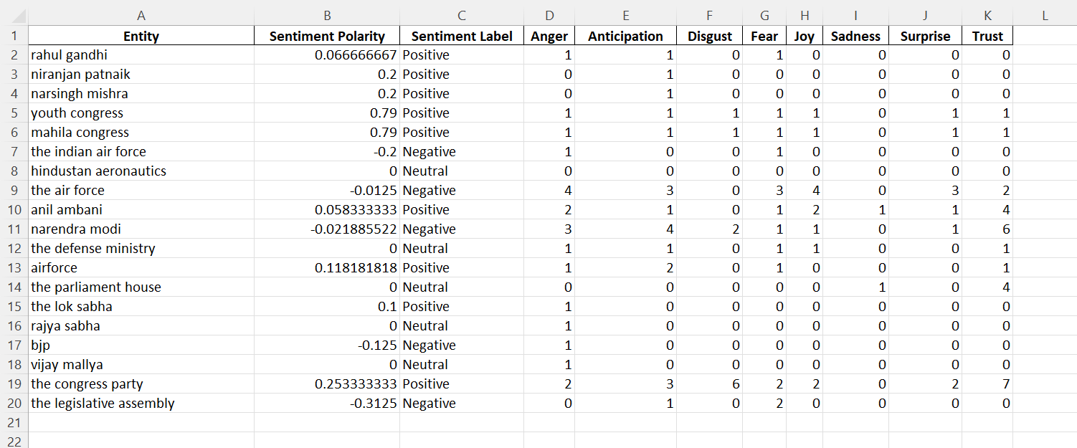
Entity Analysis of Speech

Slide 54
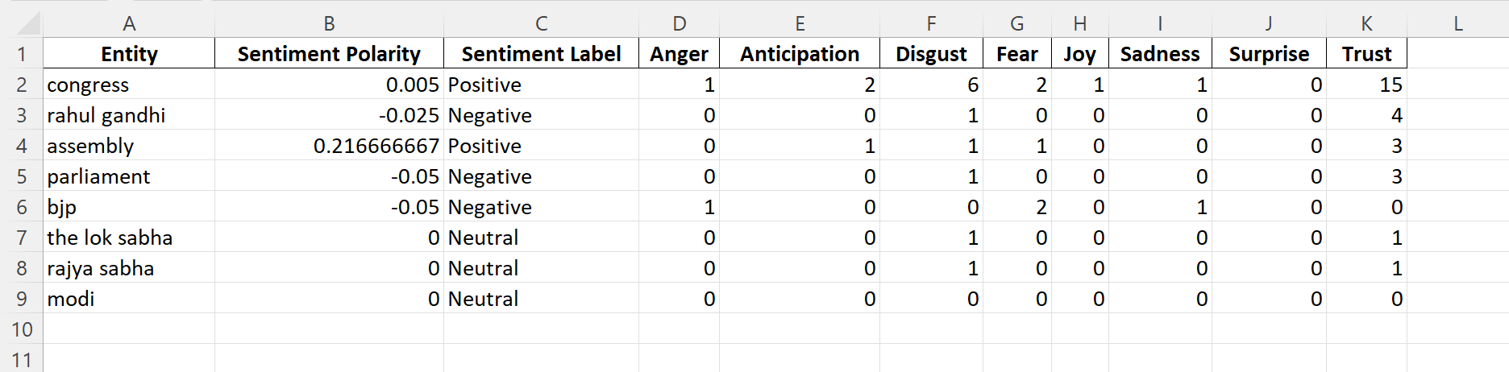
Entity Analysis of The Telegraph Online

Slide 55
Speech of Sh. Narendra Modi At Ahmednagar,
Maharashtra

Slide 56
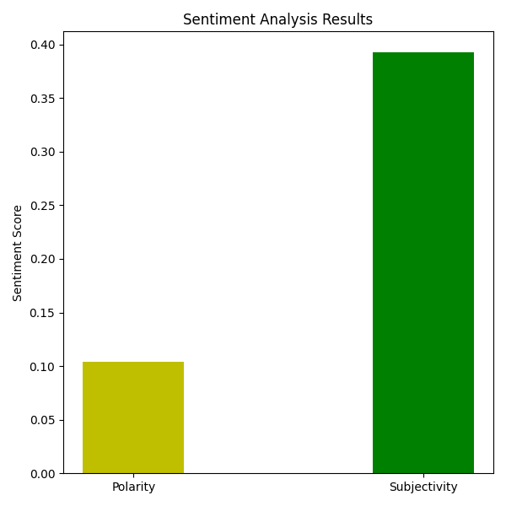
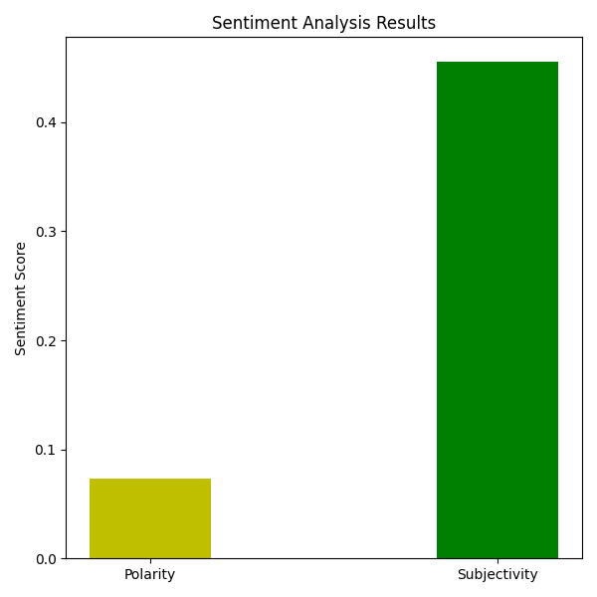

Sh. Narendra Modi Speech in Ahmednagar
Sentiment Analysis of Speech
Sentiment Analysis of THE WEEK ARTICLE
Sentiment Analysis of JAGRAN
s

Slide 57
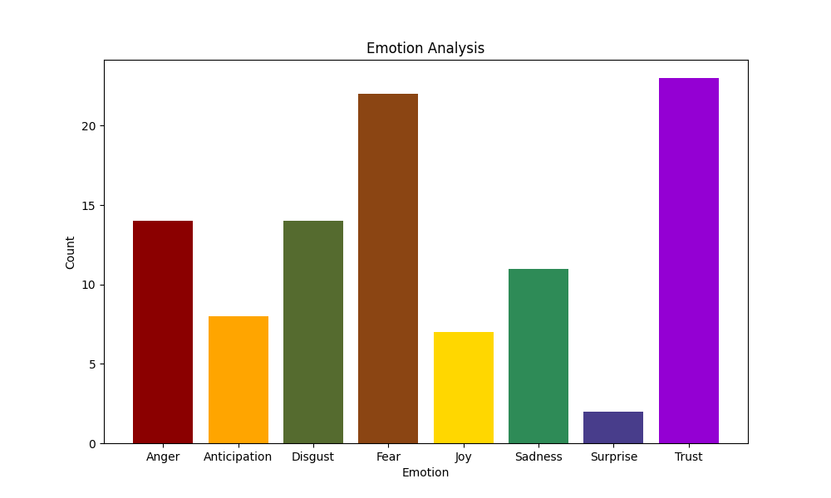

Sh. Narendra Modi Speech in Ahmednagar
Emotional Analysis of
THE WEEK ARTICLE
Emotional Analysis Of The
JAGRAN

Slide 58

Sh. Narendra Modi Speech in Ahmednagar
Emotional Analysis of Speech

Slide 59

Entity Analysis of Speech

Slide 60

Entity Analysis of The Week Article

Slide 61

Entity Analysis of JAGRAN

Slide 62
Speech of Rahul Gandhi in Moga, Punjab

Slide 63


Sh. Rahul Gandhi Speech in Punjab
Sentiment Analysis of Speech
Emotional Analysis of Speech

Slide 64

Entity Analysis of Speech

Slide 65
Connecting the dots
Article | Polarity of original speech | Polarity of article by OPIndia | Polarity of article by India Today | Polarity of article by Hindustan Times | Polarity of article by Indian Express
Wardha speech by N.Modi | 0.08 | -0.2 | 0.1 | 0.03 | 0.04
Meerut Speech by N.Modi | 0.1 | 0.25 | 0.0 | 0.09 | 0.02
Varanasi speech by N.modi | 0.9 | -0.4 | 0.03 | 0.3 | 0.01
Kolkata Speech by N.modi | 0.05 | 0.05 | 0.10 | 0.21 | -0.10

Slide 66
Connecting the dots
Article | Polarity of original speech | Polarity of article by OPIndia | Polarity of article by India Today | Polarity of article by Hindustan Times | Polarity of article by Indian Express
New Delhi speech by R.Gandhi | 0.11 | 0.01 | 0.31 | -0.12 | 0.17
Jeypore Speech by R.Gandhi | 0.09 | -0.20 | 0.06 | 0.09 | 0.12
Ahmednagar speech by N.modi | 0.17 | -0.33 | 0.10 | 0.09 | 0.20
Moga Speech by R.Gandhi | 0.02 | -0.04 | 0.12 | -0.16 | -0.10

Slide 67
Proposed Work & Literature Survey

Slide 68
Serial Number | Topic | Date Published | Authors
01 | Sentiment analysis algorithms and applications:A survey | 27 May 2014 | Walaa Medhat, Ahmed Hassan, Hoda Korashy
02 | Towards Detecting Political Bias in Hindi News Articles | May 2022 | Samyak Agrawal, Kshitij Gupta, Devansh Gautam, Radhika Mamidi
03 | Sentiment Analysis of Twitter Data | 23 June 2011 | Apoorv Agarwal ,Boyi Xie ,Ilia Vovsha , OwenRambow, RebeccaPassonneau

Slide 69
Serial Number | Topic | Date Published | Authors
04 | An Emotional Analysis of False Information in Social Media and News Articles | 19 April 2020 | Bilal Ghanem,Paolo Rosso,Francisco Rangel
05 | Named Entity Recognition Approaches and Their Comparison for Custom NER Model | 19 May 2020 | Hemlata Shelar, Gagandeep Kaur, Neha Heda, Poorva Agrawal
06 | A survey on sentiment analysis challenges | 27 September 2018 | Doaa Mohey El-Din Mohamed Hussein

Slide 70
Limitations
Delivery of Speech also matters
Lack of Deep Learning Model

Slide 71
Future Work
Topic Modelling
Analysis of audio and video as well as text
Emotions driven by an entity
Increase the Dataset

Slide 72
References
[1] Burns, W. J. (2019). NRC Emotion Lexicon. Retrieved from https://www.kaggle.com/datasets/wjburns/nrc-emotion-lexicon
[2] FreeCodeCamp. (2019, May 29). What is Sentiment Analysis? A Complete Guide to for Beginners. Retrieved from https://www.freecodecamp.org/news/what-is-sentiment-analysis-a-complete-guide-to-for-beginners/
[3] Chen, S., Cao, Y., & Huang, Y. (2022). Text-Based Emotion Detection: An Overview of Approaches and Applications. Frontiers in Psychology, 13, 835149. doi: 10.3389/fpsyg.2022.835149
[4] Stanford University. (2017, May 2). CS224n 2017 Lecture 6: Language Models and RNNs. Retrieved from https://youtu.be/O_2uq0sdCQo

Slide 73
References
[5] Pang, B., & Lee, L. (2008). Opinion mining and sentiment analysis.
Foundations and Trends in Information Retrieval, 2(1-2), 1-135.
[6] Li, X., Bing, L., Lam, W., & Zhang, W. (2018). End-to-end adversarial
memory network for cross-domain sentiment classification. Proceedings of
the Thirty-Second AAAI Conference on Artificial Intelligence, 6007-6014.
[7] Cambria, E., & Hussain, A. (2015). Sentic computing: A
common-sense-based framework for concept-level sentiment analysis.
Springer International Publishing.
[8]Hassan Yousef, Ahmed & Medhat, Walaa & Mohamed, Hoda. (2014).
Sentiment Analysis Algorithms and Applications: A Survey. Ain Shams
Engineering Journal. 5. 10.1016/j.asej.2014.04.011.

Slide 74
THANK
YOU

